Slide 1
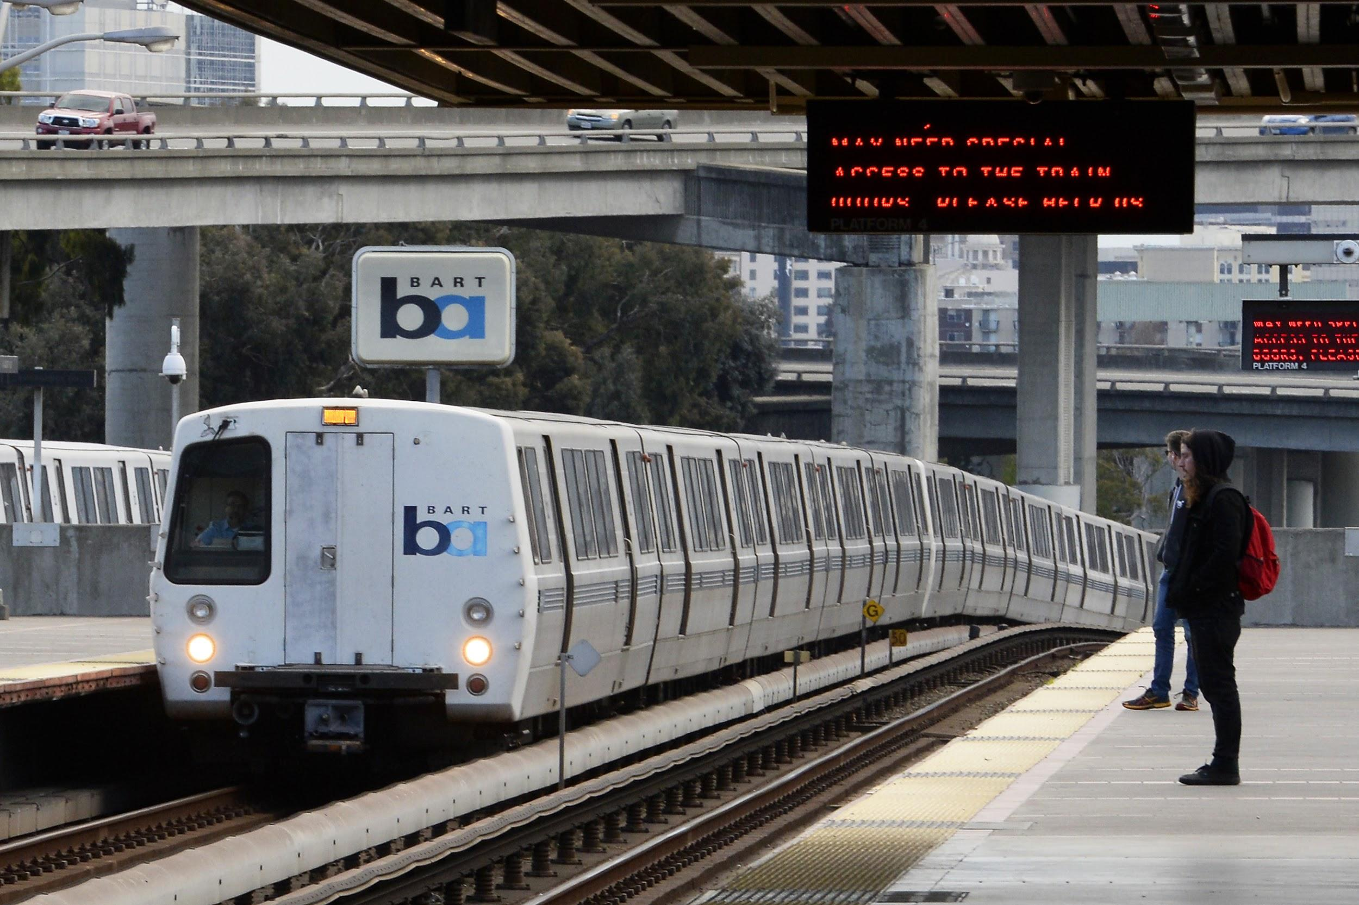
BART
2018 ridership
UCB Ext Data Analytics
Project-2 Presentation
Rosa, Grace, Ryan, Dan

Slide 2
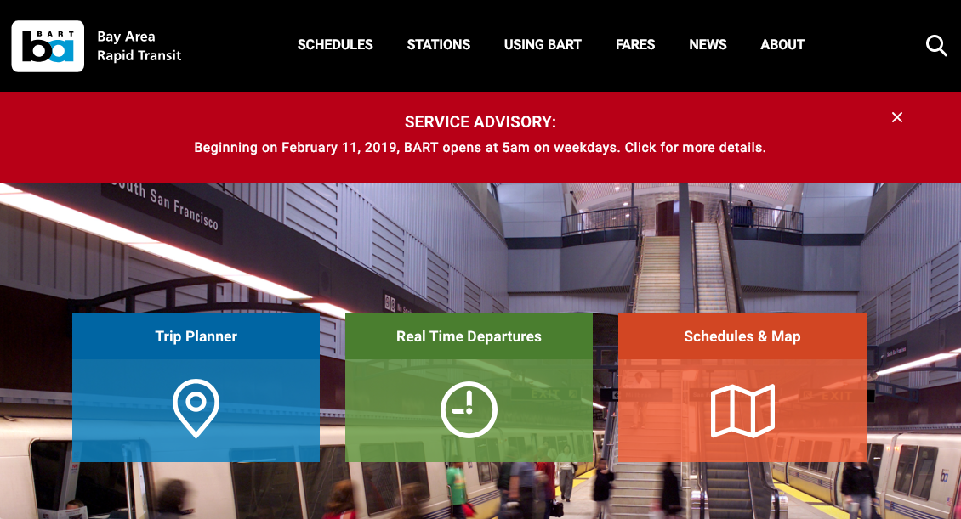
what happens to ridership over time?
-and in which stations?

Slide 3
bartData
two main sources:
BART API for station metadata only
Station abbreviation, name, lat/lng, address
BART csv/Excel reports for ridership to/from each station
1 file per month
Two new stations did not exist in before April 2018
Two other stations are not operational
Not all months had weekend traffic or Sun - Sat overall info, so we used the most consistent data: AVG WEEKDAY TRAFFIC

Slide 4

dataMunging (Python)
1. Loaded 12 Excel files into ipynb. Prepared data to send to MySQL.
Python libraries:
pandas, numpy, functools, itertools, datetime, calendar, requests, json
ORM:
SQLAlchemy
Pittsburg/Bay Point - SFO/Millbrae

Slide 5
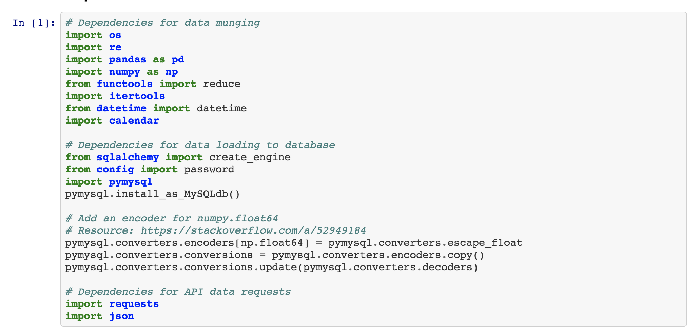
ipynb
Pittsburg/Bay Point - SFO/Millbrae

Slide 6
dataBase (SQLAlchemy, MySQL)
2. Sent cleaned data to MySQL:
Pymysql library
Shortcut configuration between SQLAlchemy & Python!
Two databases:
metadata (BART API data of 50 stations; 50 records)
ridership (2018 data from ipynb file; 30,000 records)
Dublin/Pleasanton - Daly City

Slide 7
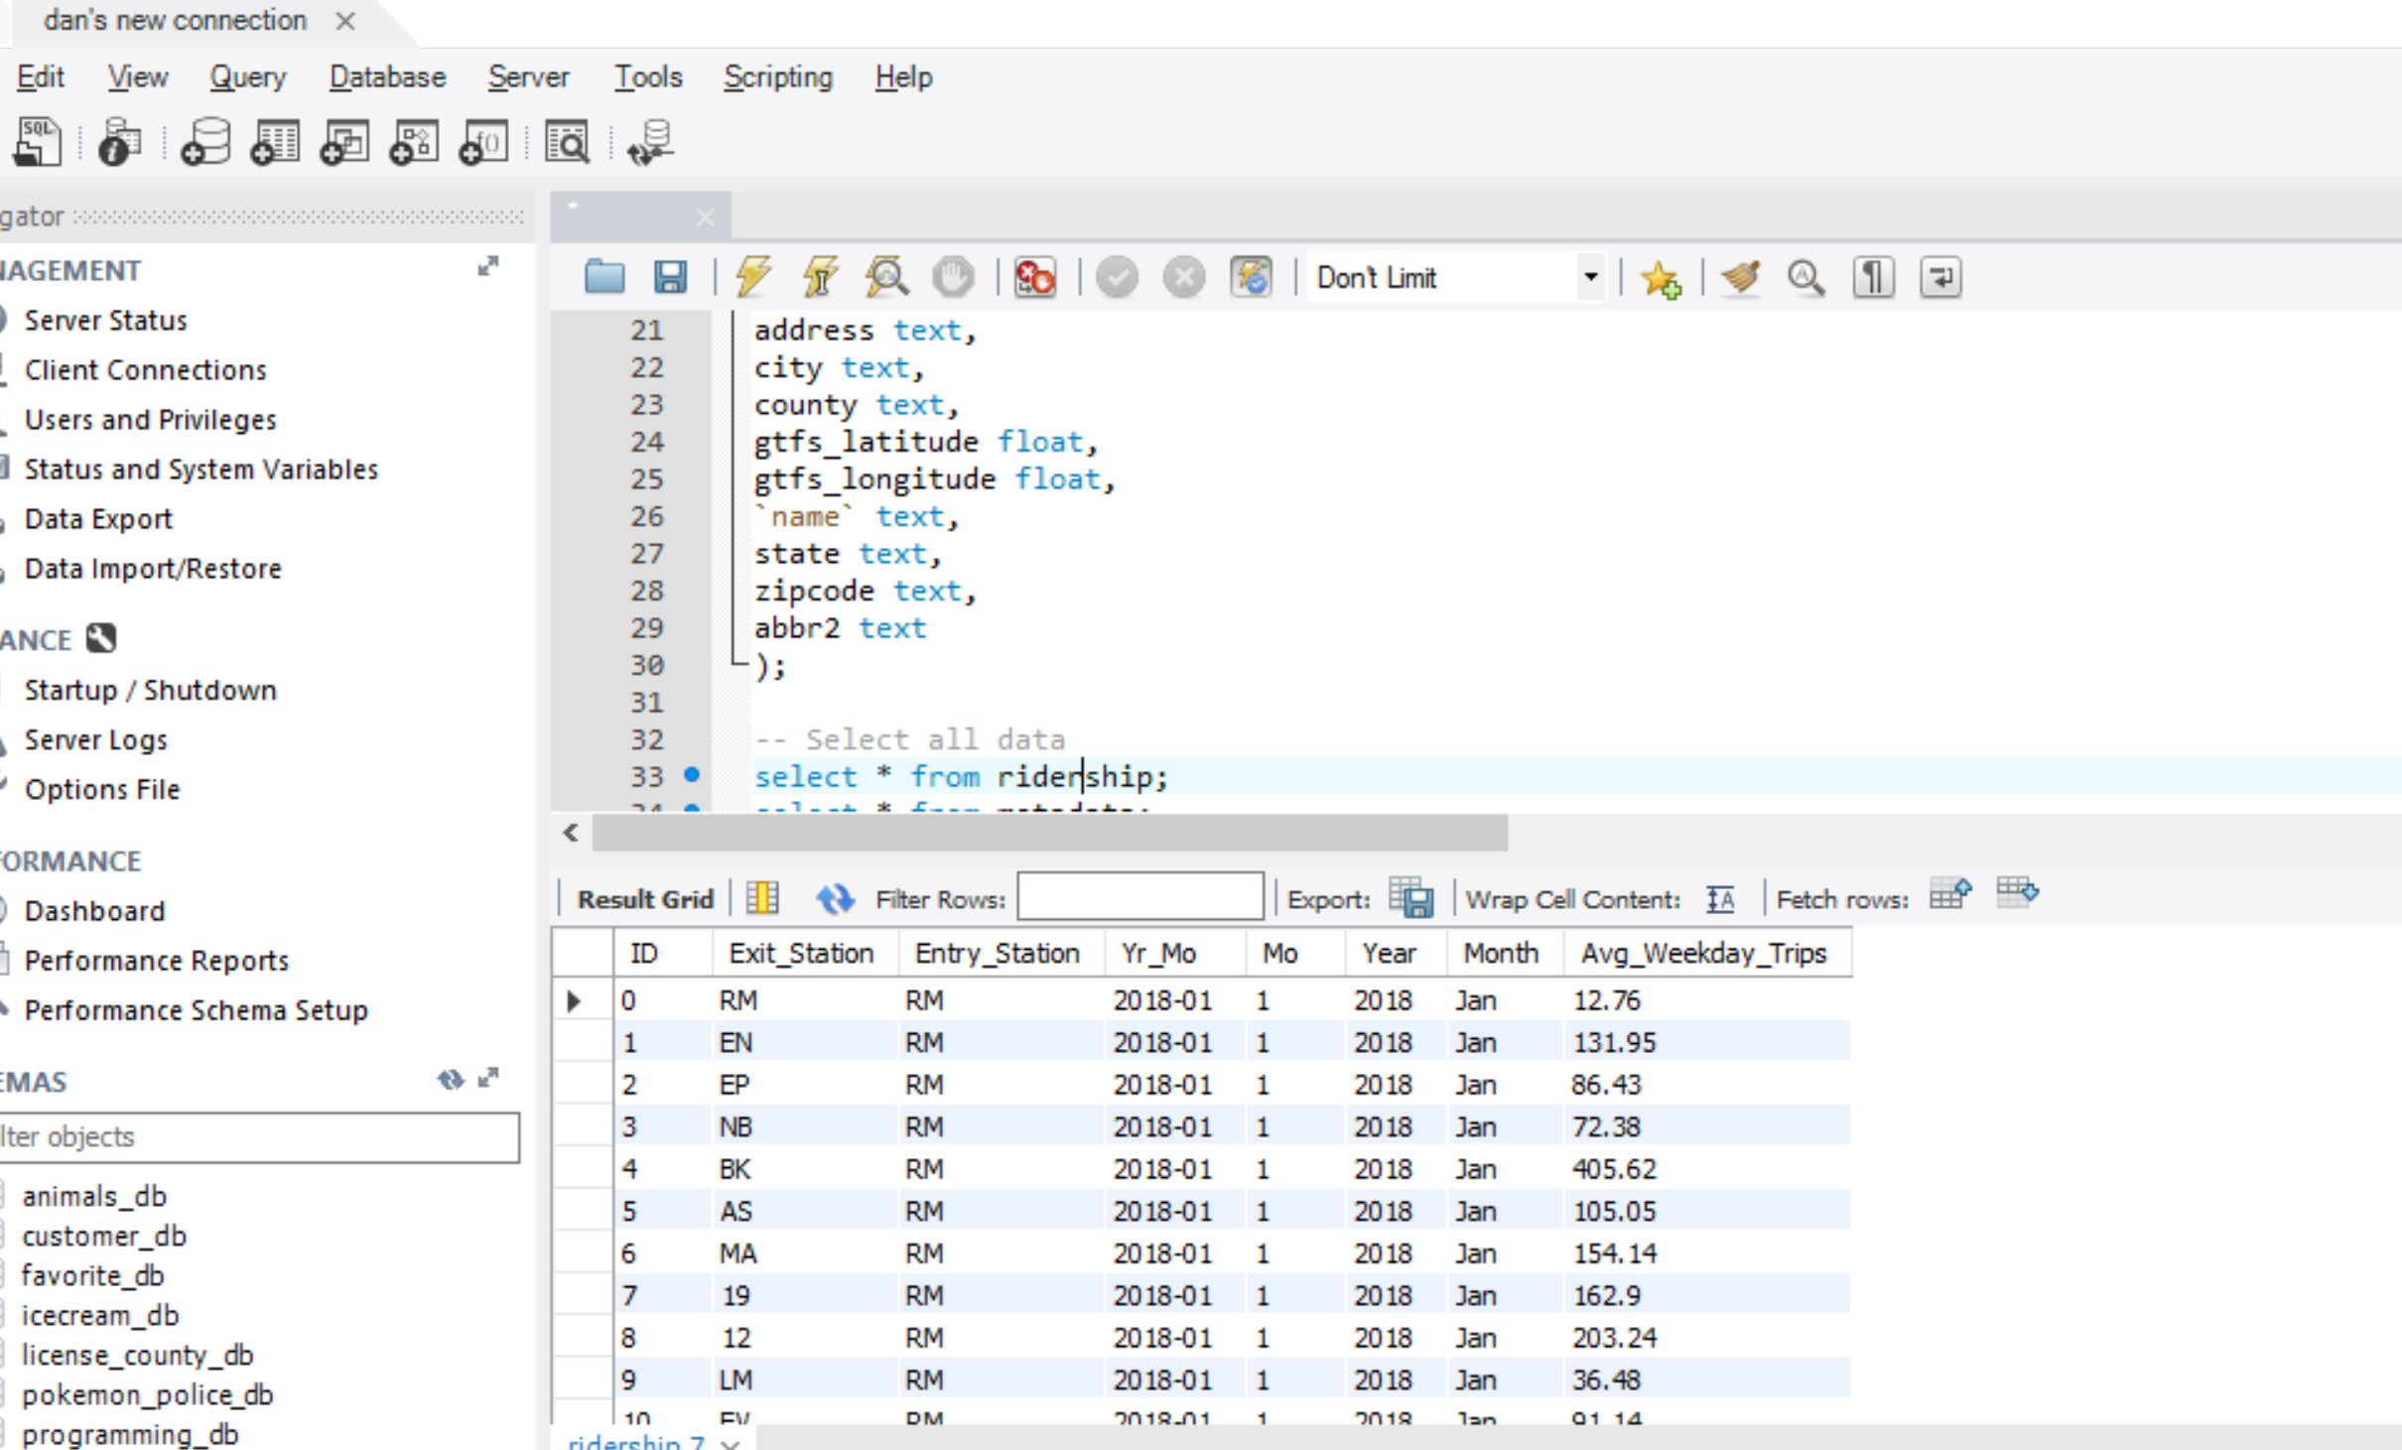
dataBase (SQLAlchemy, MySQL)
Dublin/Pleasanton - Daly City

Slide 8
app.py (Flask)
3. Create Flask routes from database tables:
@app.route(‘/’)
@app.route(‘/metadata’)
@app.route(‘/data’)
Merged metadata and ridership tables on 2-digit station abbr
@app.route(‘/trips’)
Merged metadata and ridership tables on 2-digit station abbr, county
+ more...
Richmond - Fremont

Slide 9
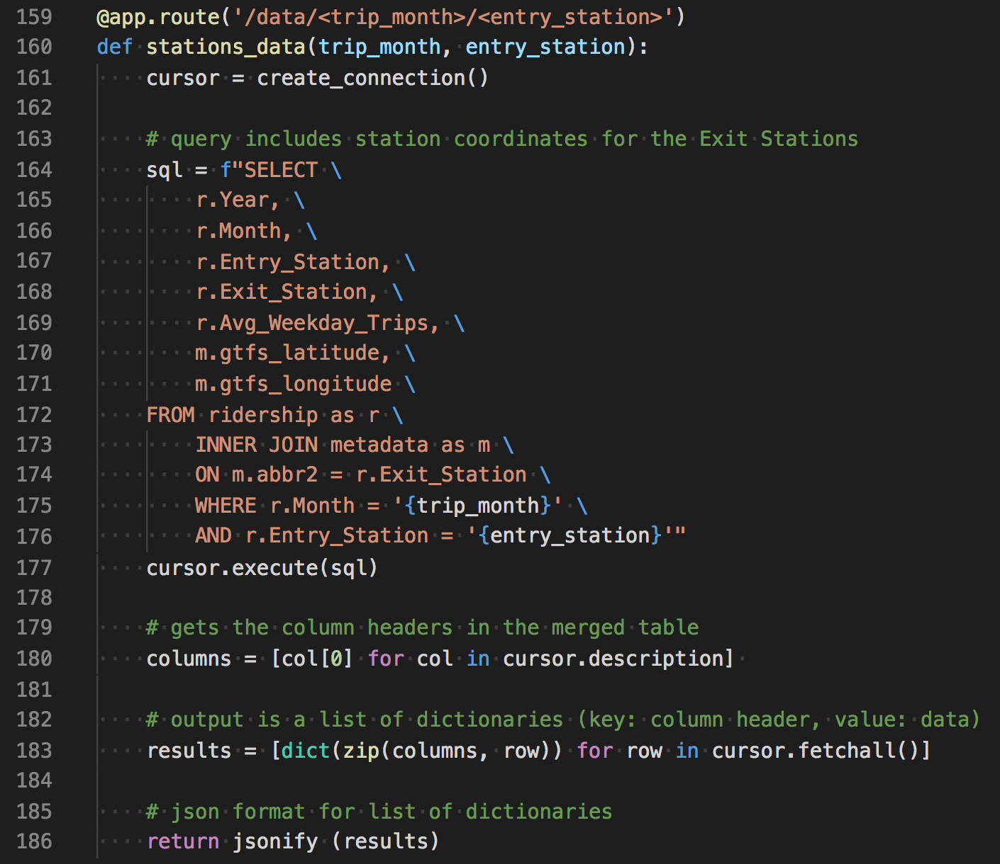
app.py (Flask)
Richmond - Fremont

Slide 10
logic, chord, scatter, functions, radial (js)
4. Created different JavaScript files for each visualization idea:
logic.js for Leaflet and D3 rendering directly from BART metadata API
chord.js for ZingChart chord diagram
Radial.js for am4Charts interactive bar chart
scatter.js for Leaflet and D3 rendering from Interactive Month & Entry Station drop down menus
Fremont - Daly City

Slide 11
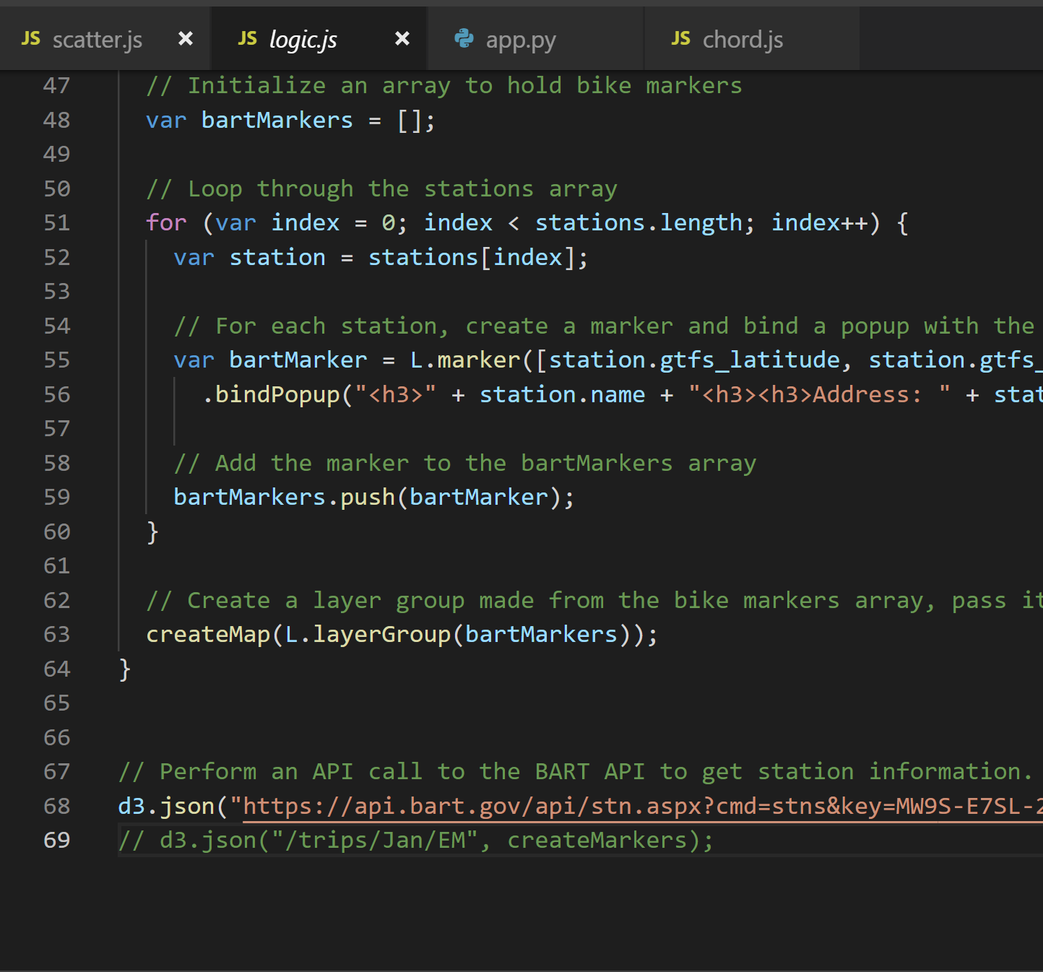
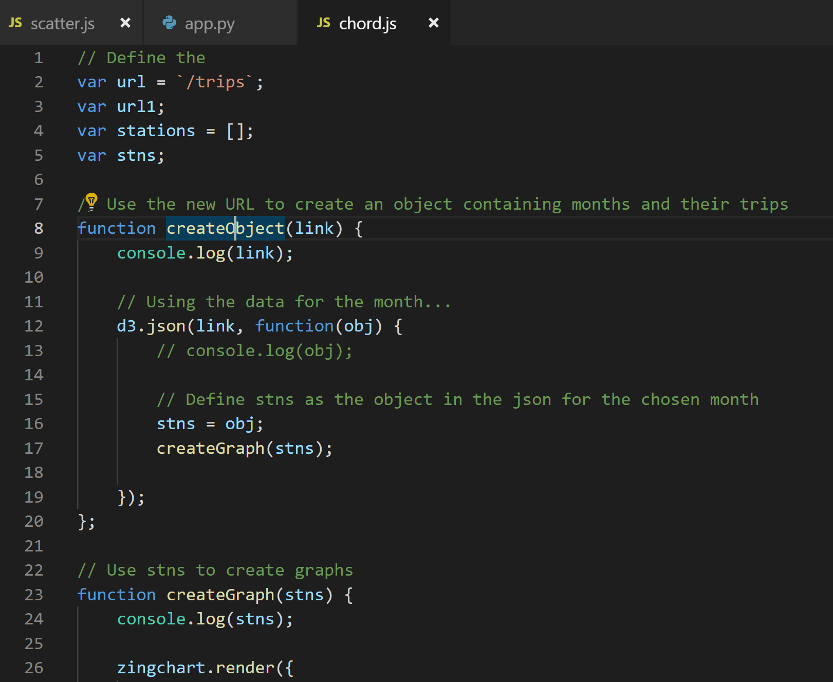
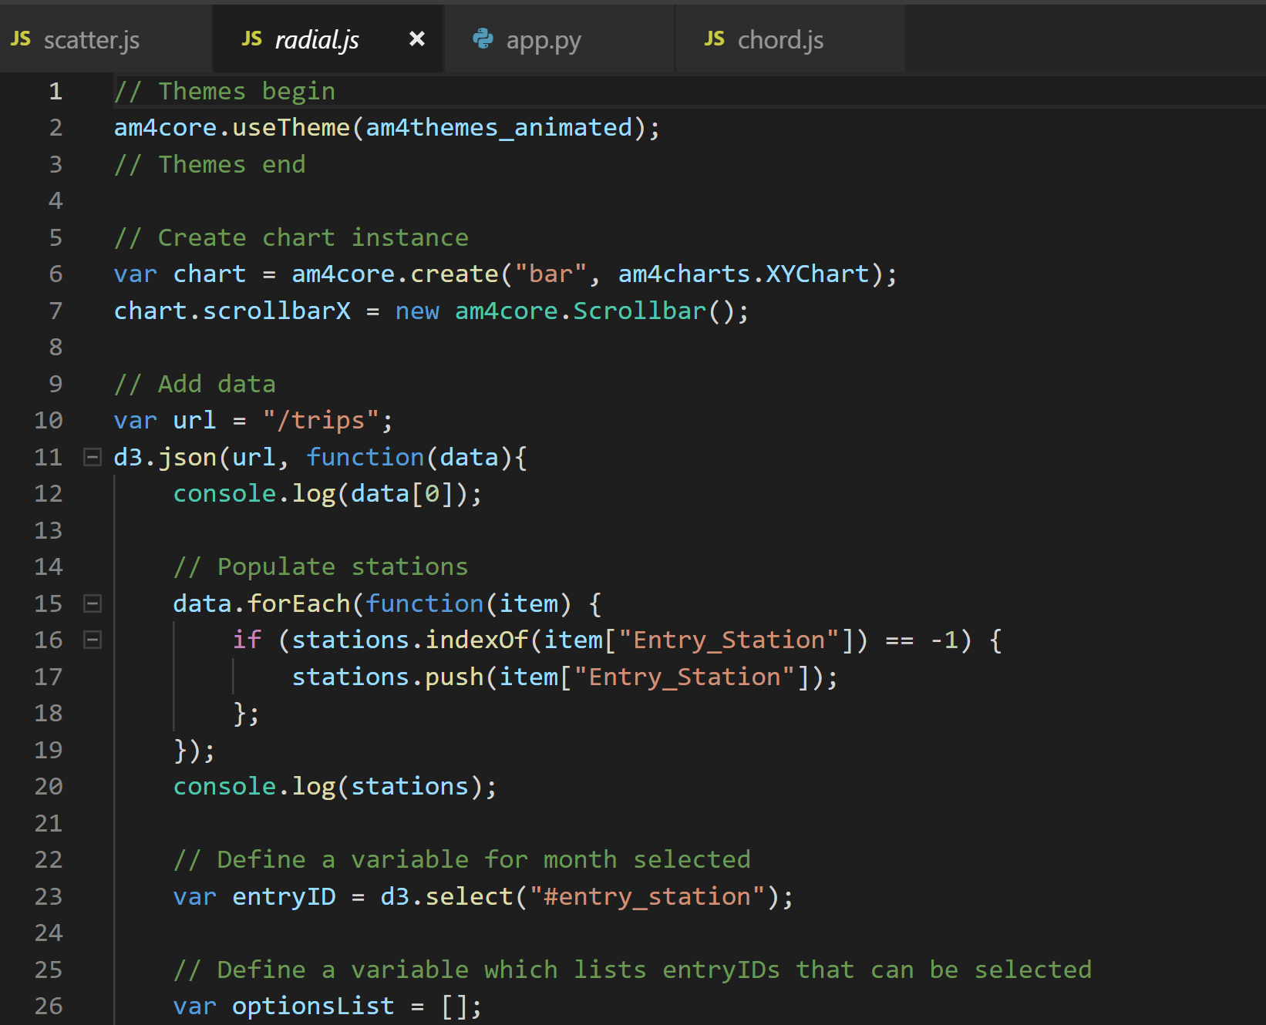
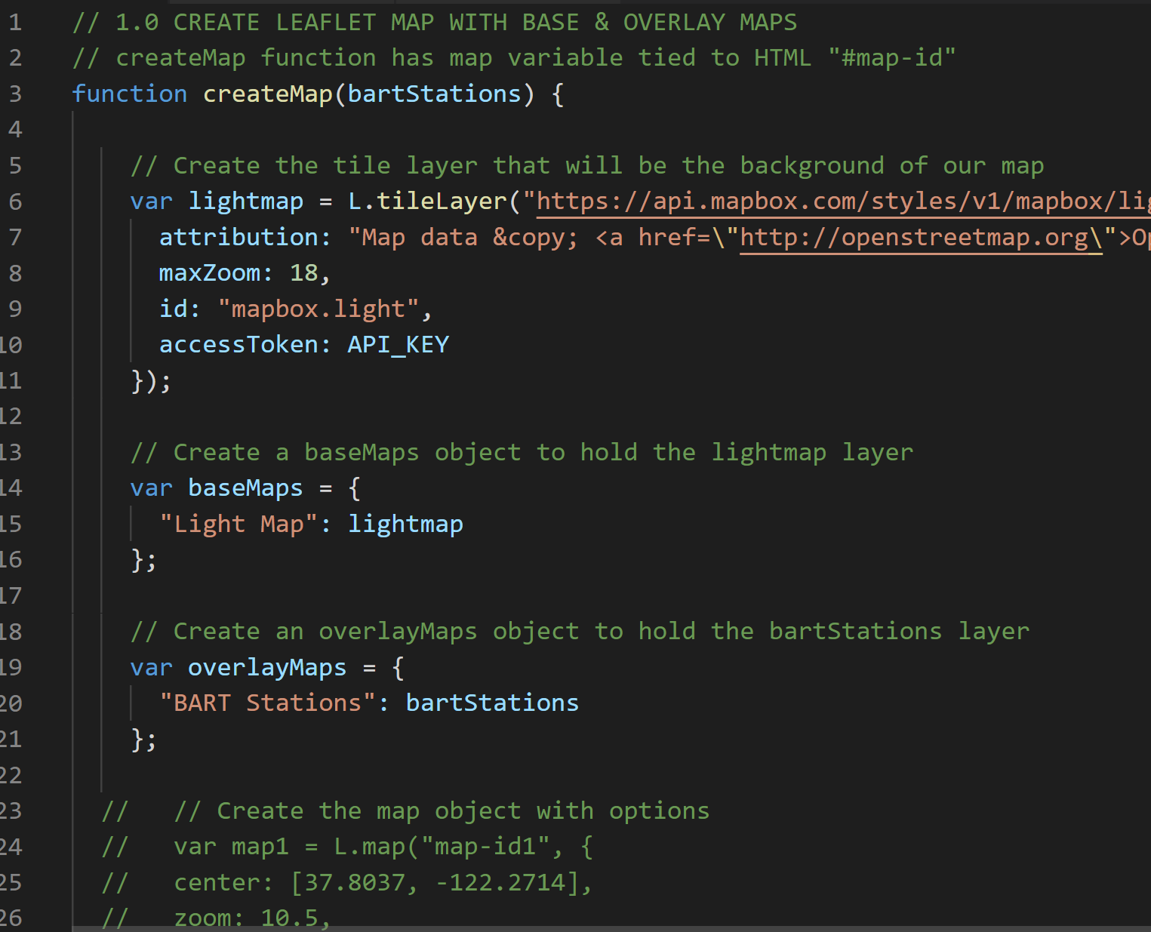
logic, chord, scatter, functions, radial (js)
Fremont - Daly City

Slide 12
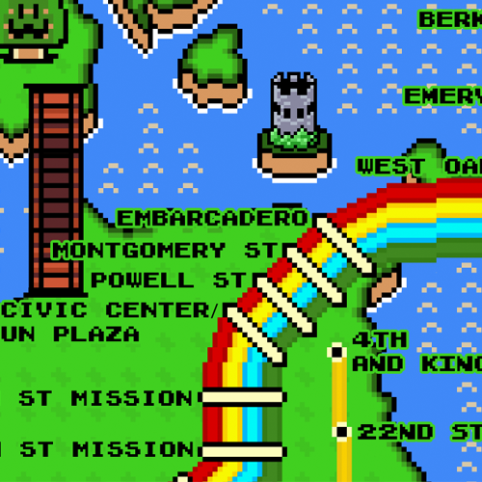
Visualizations

Slide 13
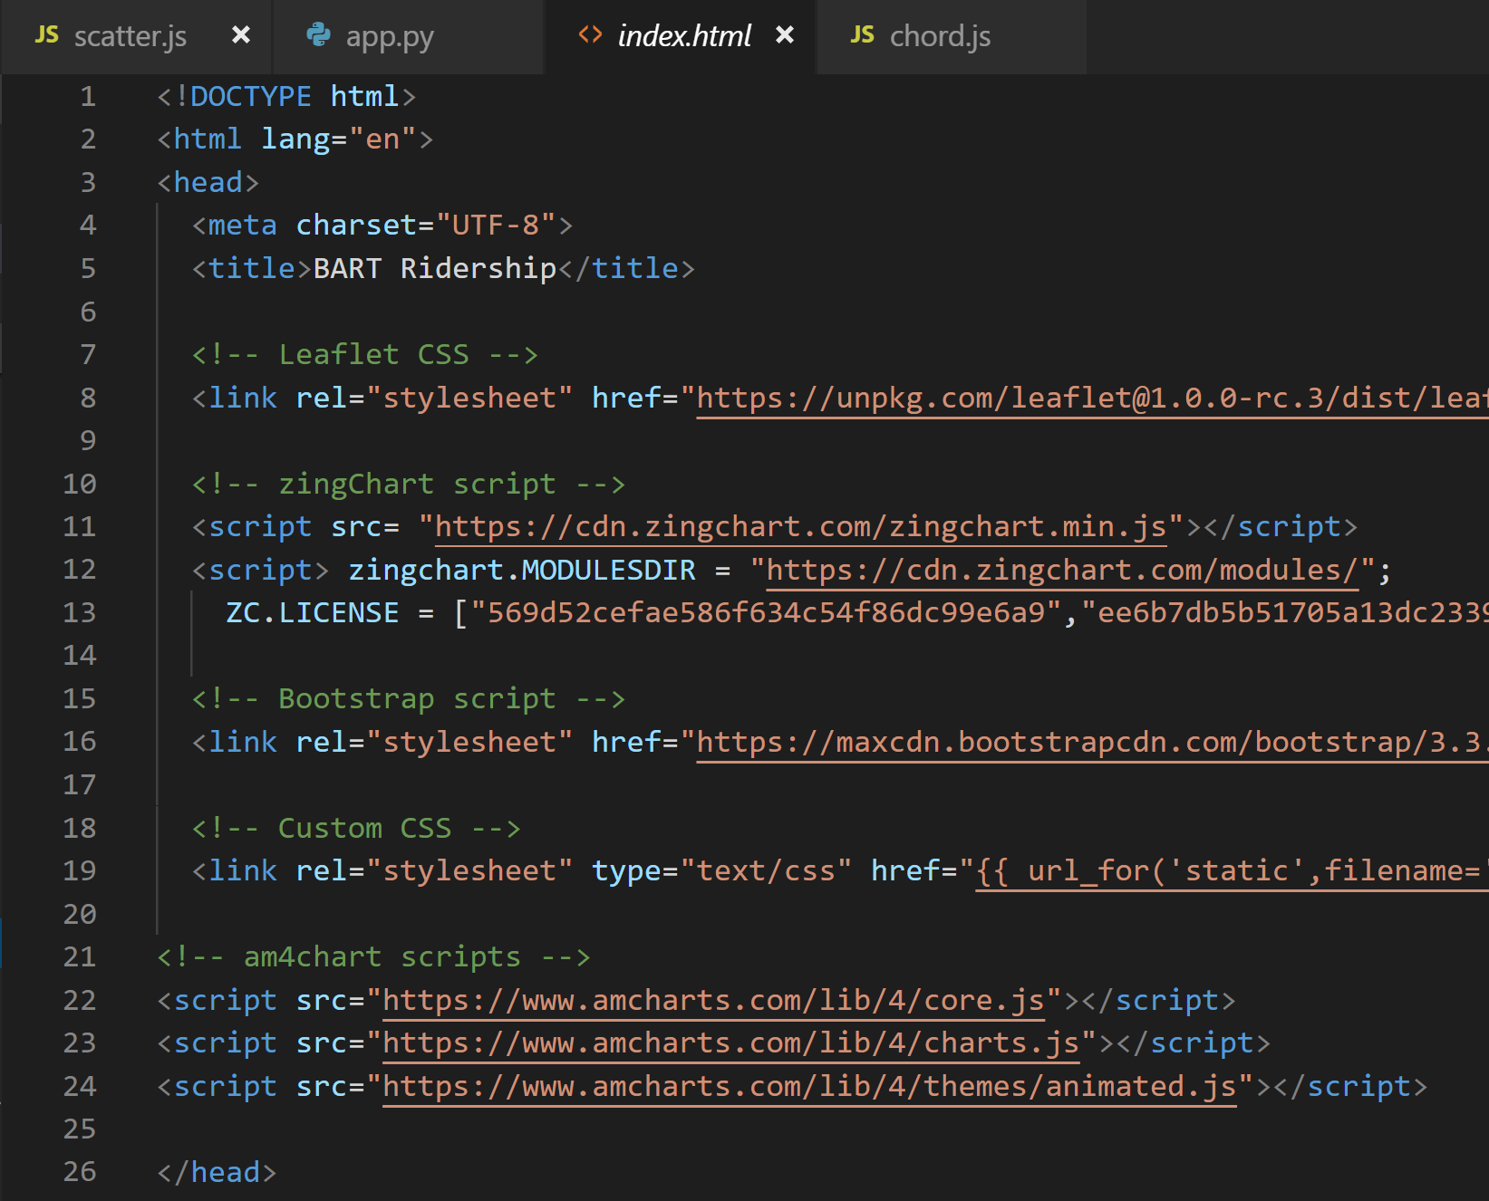
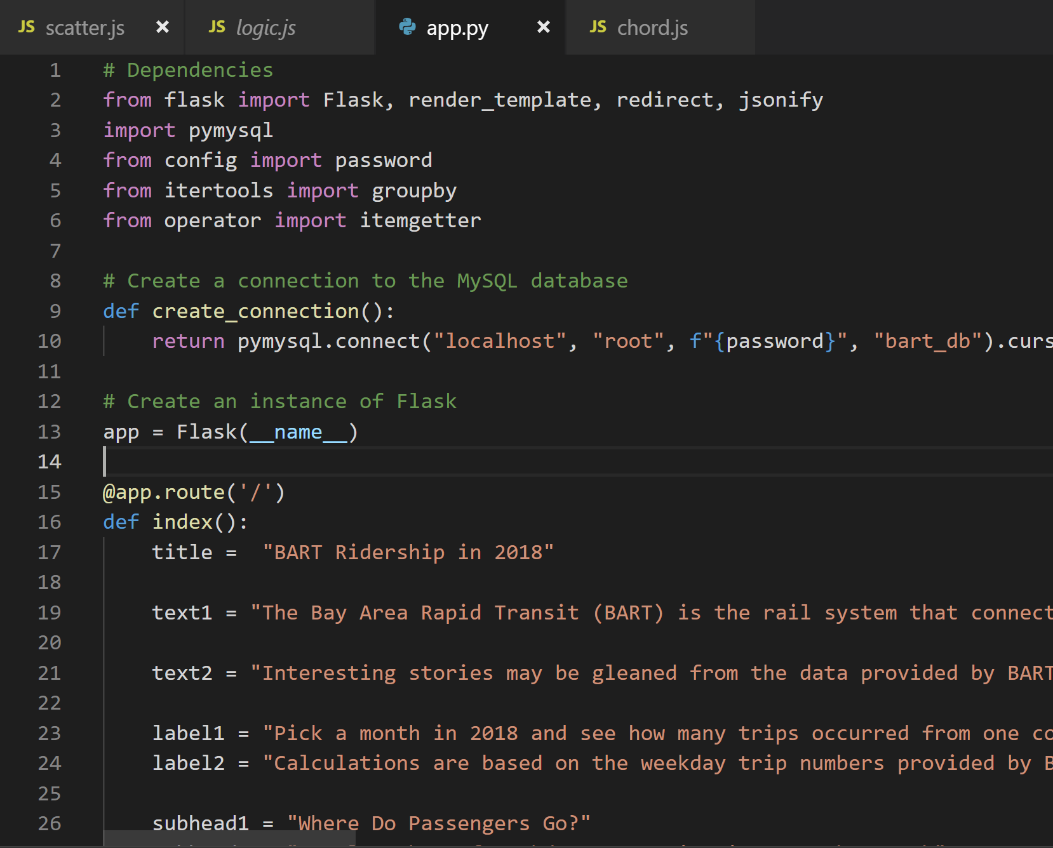
index.html, app.py

Slide 14
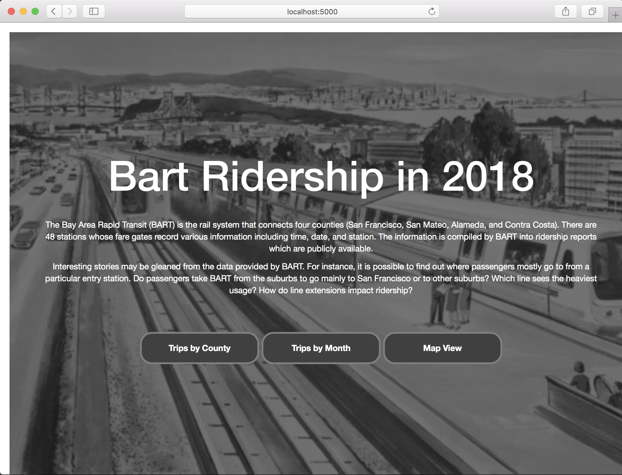

Slide 15
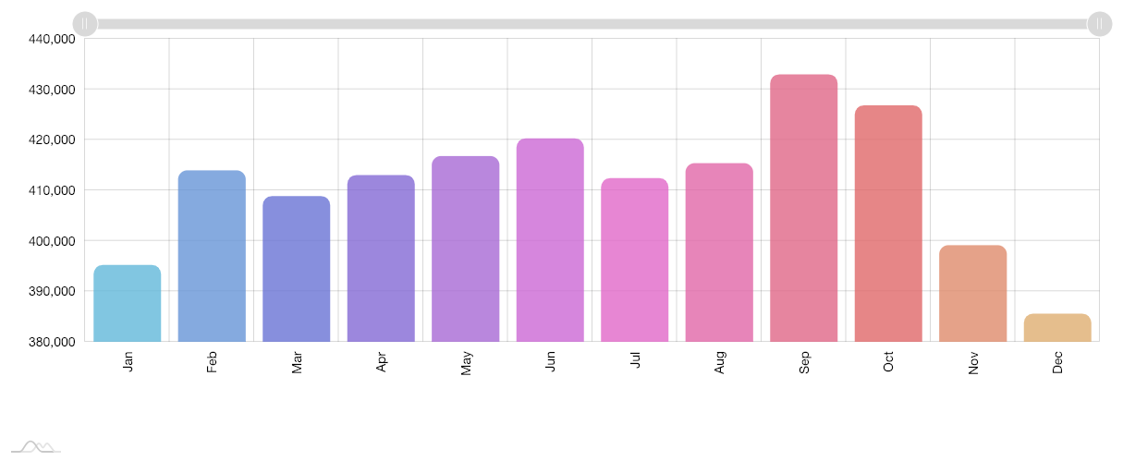

Slide 16
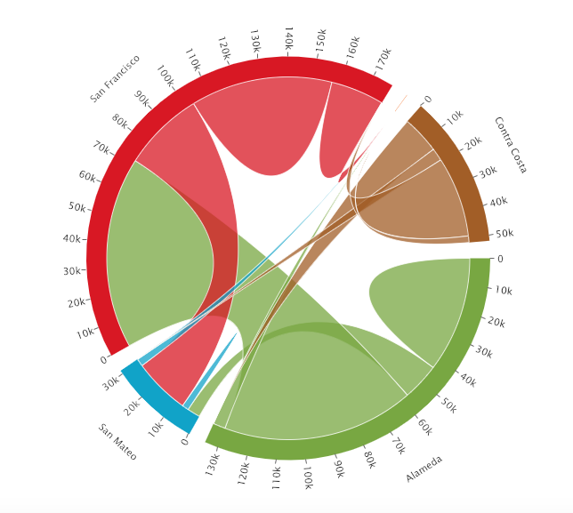

Slide 17
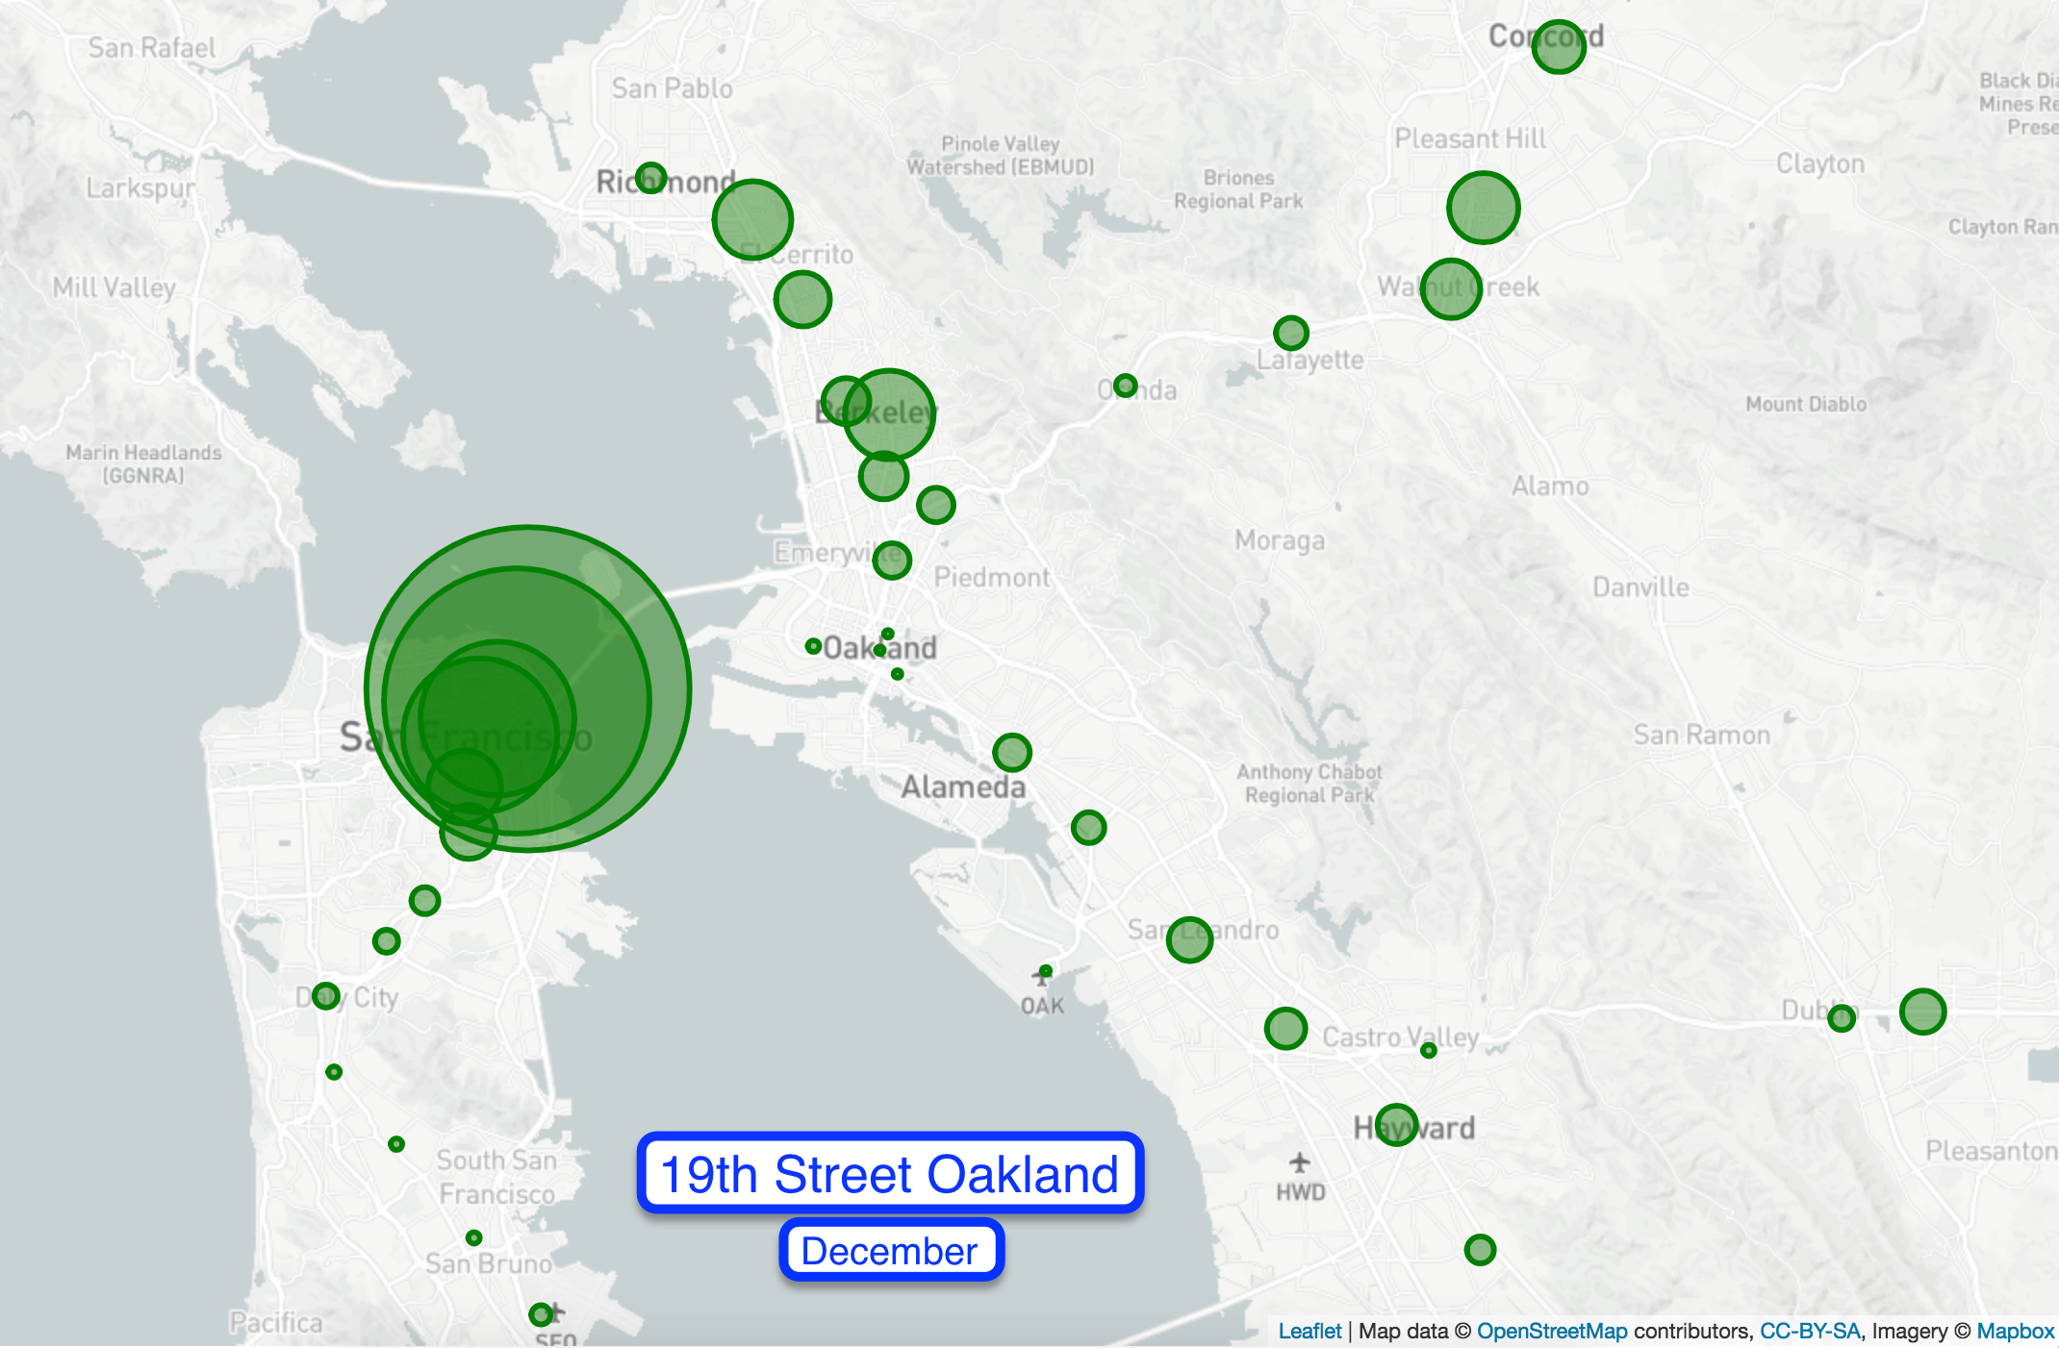

Slide 18
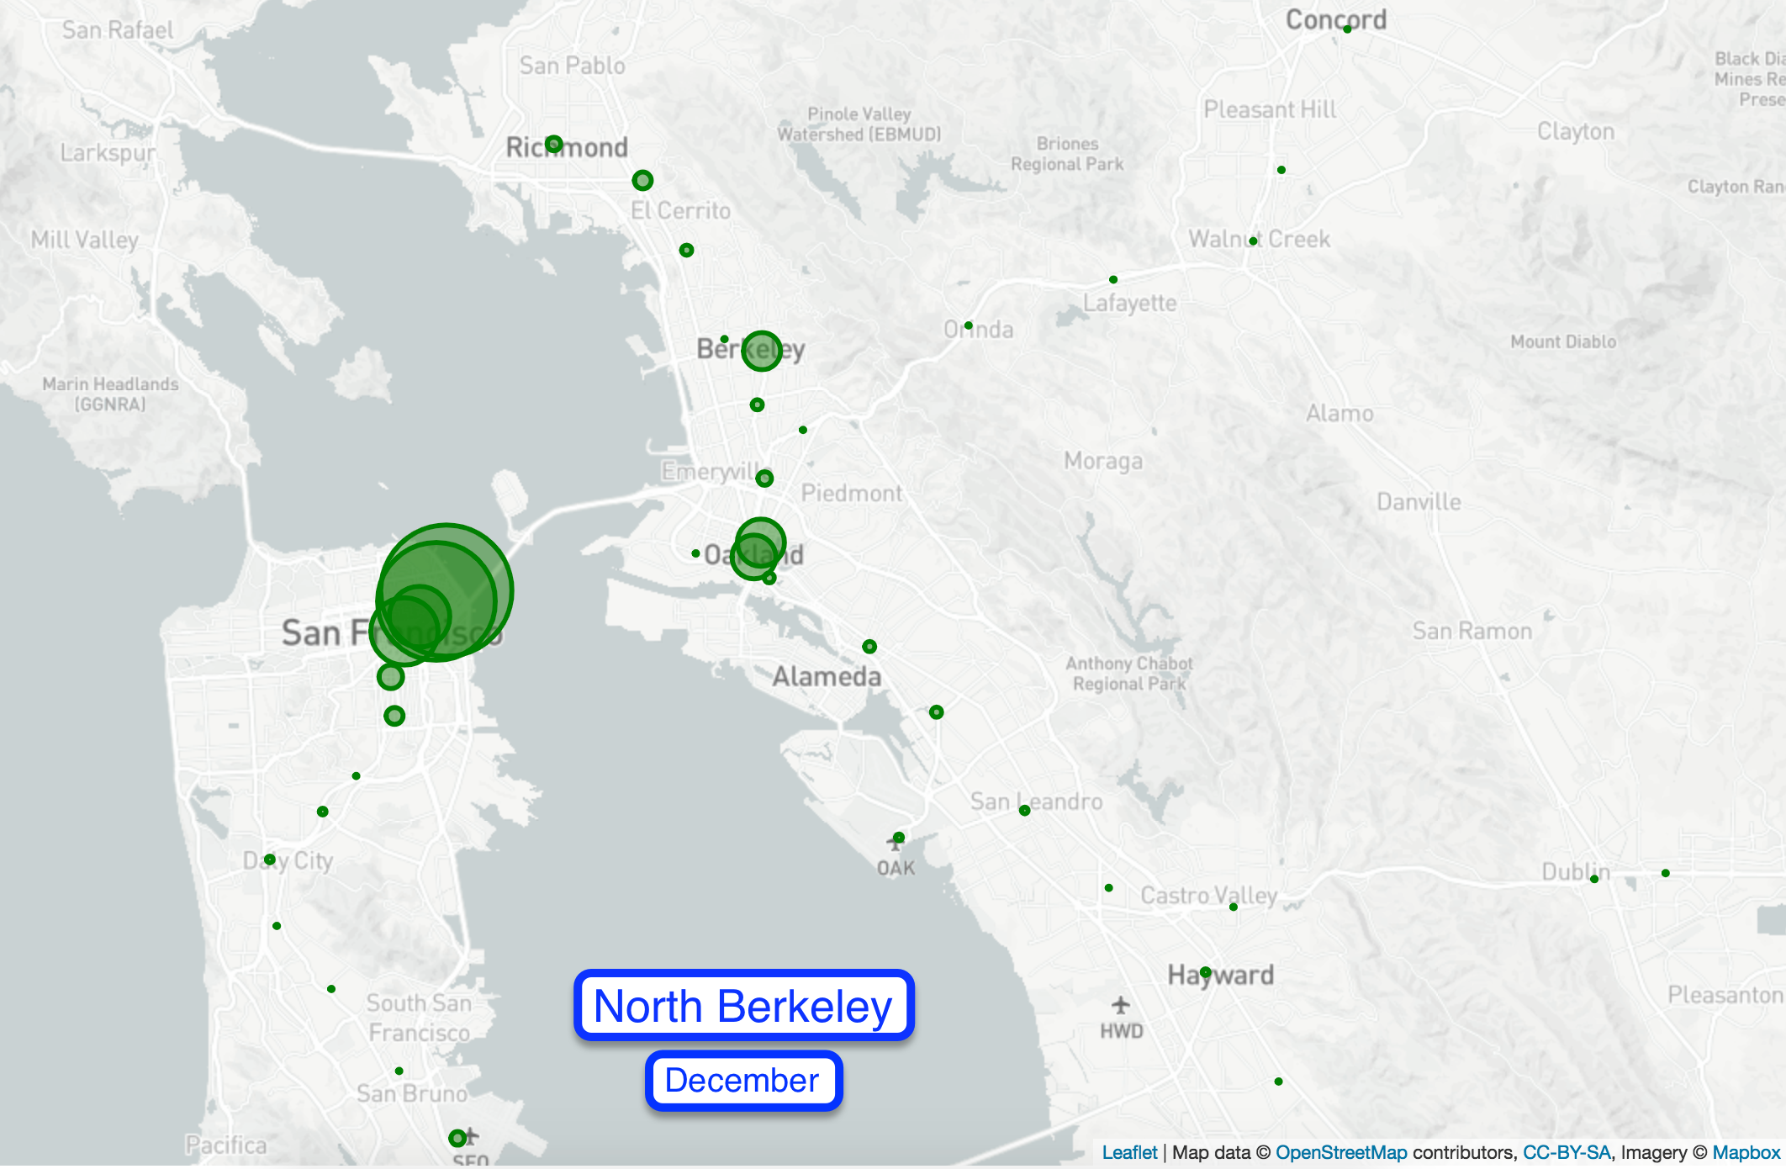

Slide 19
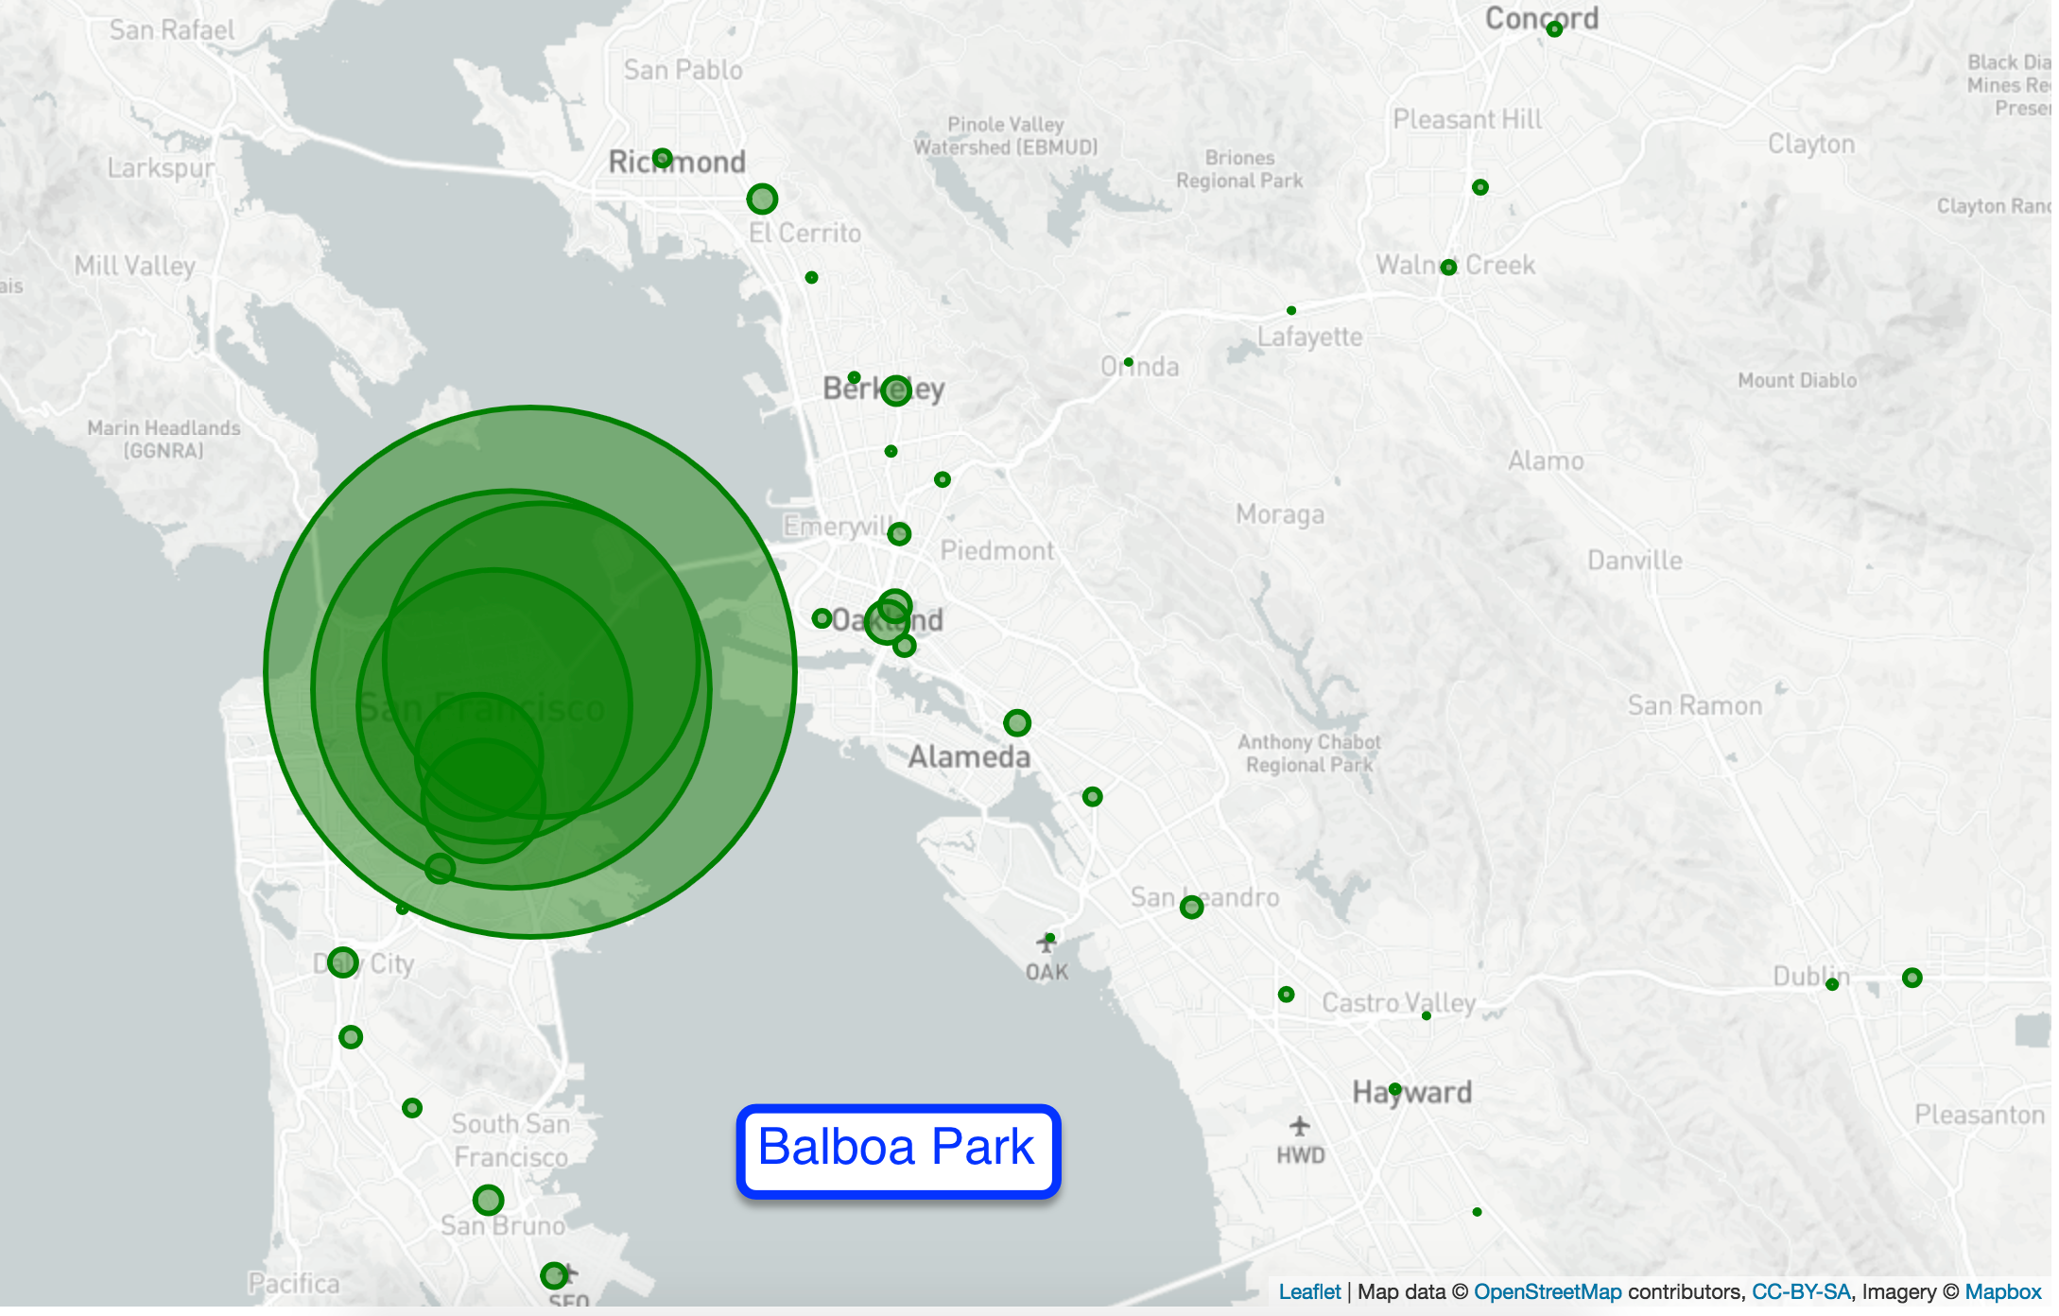

Slide 20
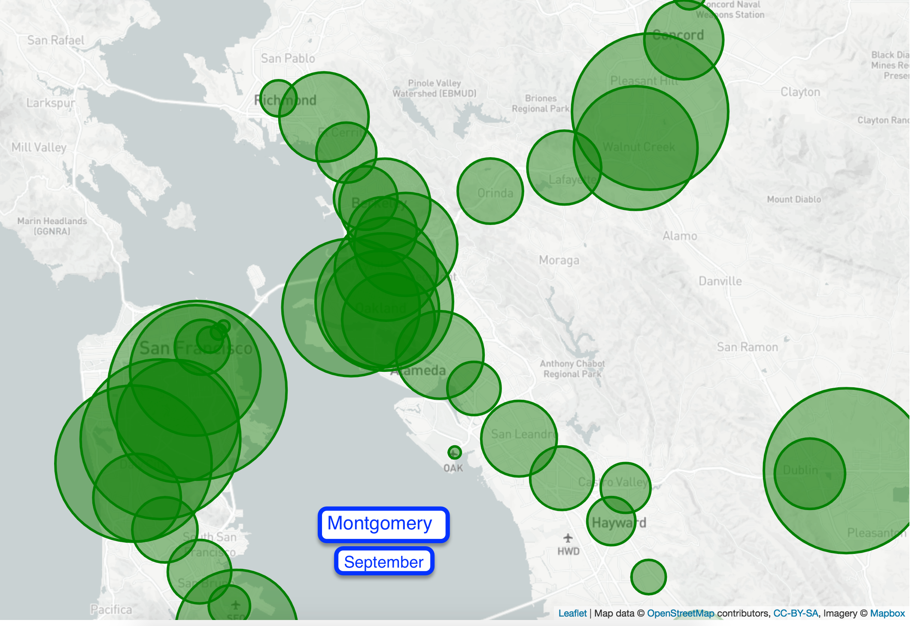

Slide 21
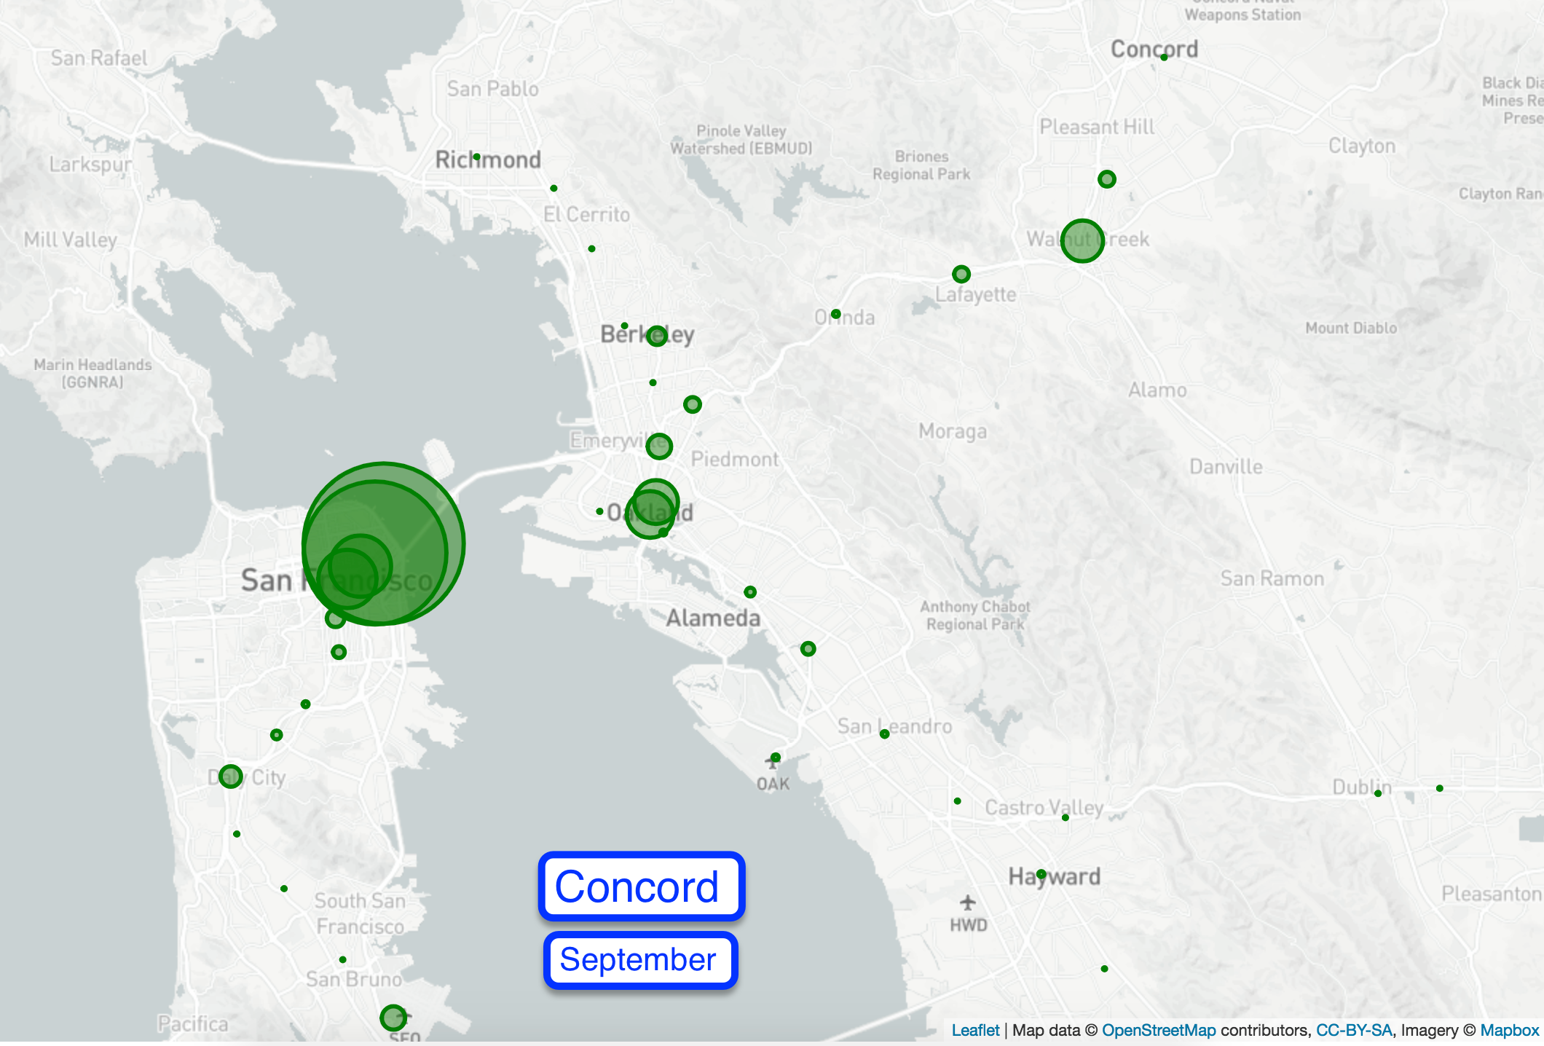

Slide 22
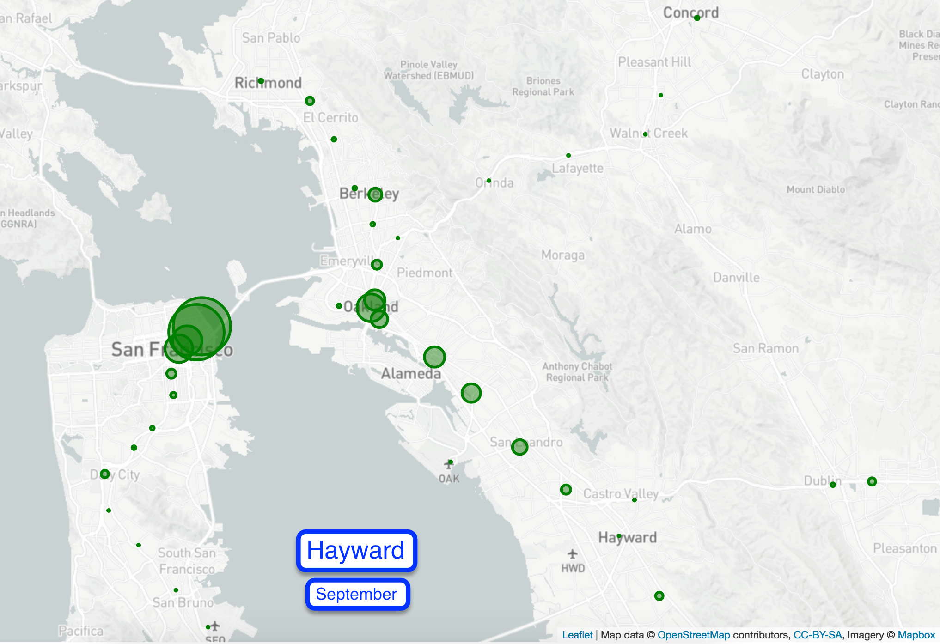

Slide 23
overallAnalysis
5. From all charts:
Traffic does not really vary for individual station by month with few exceptions:
December has less M-F traffic; likely explained by holidays
September has much more M-F traffic; likely explained by school back in session
More people ride BART to leave SF than to come
Alternate modes of transportation (AC Transit, Ferry, etc.)
No carpool lane leaving SF on Bay Bridge
Richmond - Millbrae

Slide 24
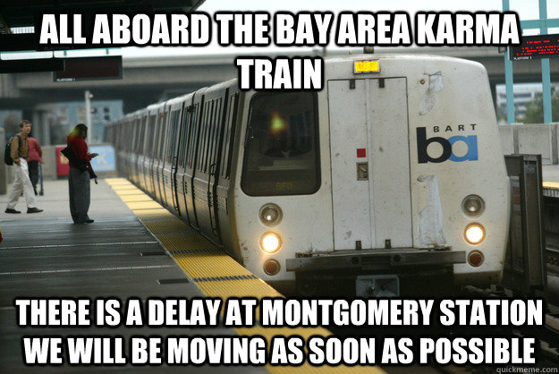
DELAYS

Slide 25
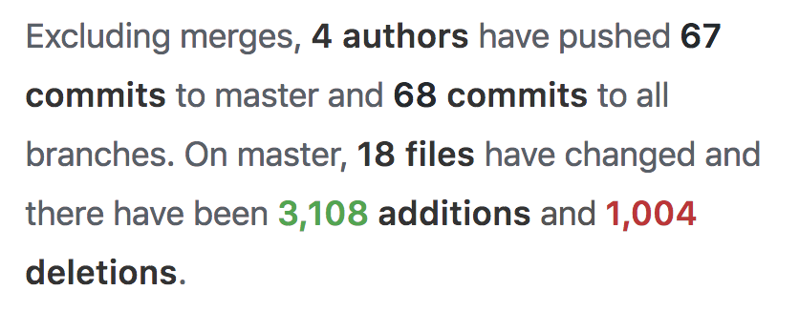
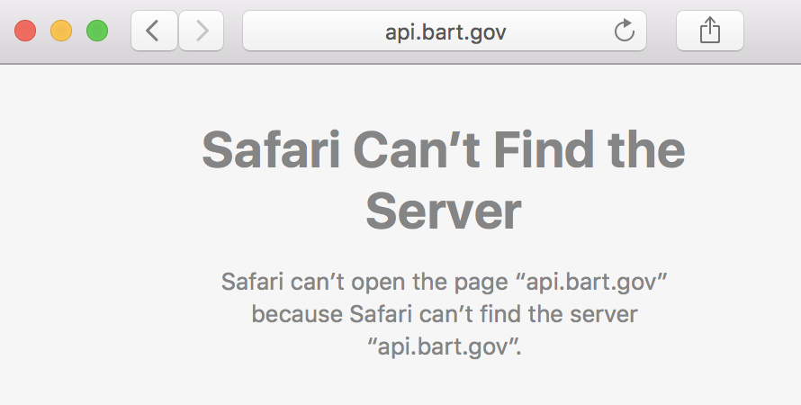
lessons learned
Github is useful… if you know what you’re doing.
Difficult to render two leaflet maps in same index.html page.
Difficult to render correct API format for ZingChart and am4Charts in app.py.
BART API under construction so we couldn’t board the API trains. Took valuable time to wrangle data into DB.
Difficult to make for loop in Jinja for 50 station names

Slide 26

thank you!

